Slide 1


PROJECT REPORT ON
Evaluation of Molecular Viability In Reactional Patients of Leprosy
Submitted
To
Department of Biotechnology
GLA University, Mathura
Supervisor
Dr. Jyoti Gupta
(Internal Guide)
Asst. Professor
Department of Biotechnology GLA University
Submitted By
Gopal Singh
2484300006
M.Sc. Biotechnology
Semester IV
Supervisor
Dr. Itu Singh
(External Guide)
Scientist In-Charge
Stanley Browne Research Laboratory, New Delhi
GLA UNIVERSITY, MATHURA
2025–26

Slide 2
Acknowledgement
I sincerely thank my Internal Guide, Dr. Jyoti Gupta, and External Guide, Dr. Itu Singh, for their valuable guidance, encouragement, and support throughout this study.
I also express my gratitude to the Department of Biotechnology, GLA University, and Stanley Browne Research Laboratory, New Delhi, for providing the necessary facilities to carry out this research.
Finally, I thank my family, friends, and everyone who supported me during this work.
Gopal Singh

Slide 3
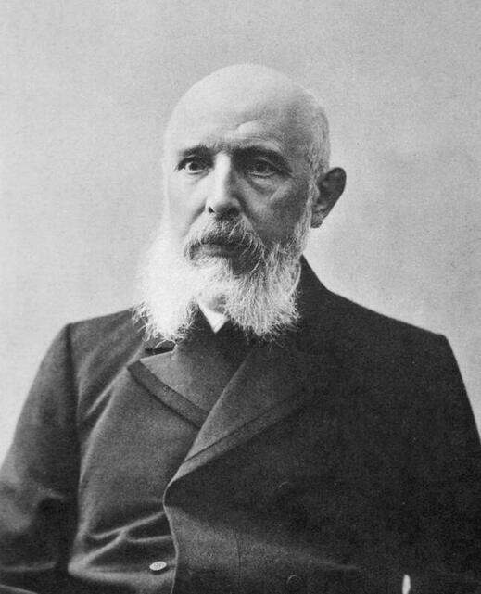
Leprosy Disease
Leprosy (Hansen's Disease) is a chronic infectious granulomatous disease caused by Mycobacterium leprae and Mycobacterium lepromatosis.
Primarily affects the skin, peripheral nerves, upper respiratory tract mucosa, and eyes; transmitted through prolonged close contact with untreated patients, and if left untreated can cause nerve damage, disability, and deformities, although it is curable with early multidrug therapy (MDT).
Mycobacterium leprae is a Gram-positive, acid-fast bacillus (AFB), appearing as a straight or slightly curved rod shaped (1–8 μm length × 0.2–0.5 μm diameter) and stained by Zeihl-Neelsen Staining.
Genome Size of M. leprae is approximately 3.27 mb .
https://www.stfrancisleprosy.org/armauer-hansen.html
Figure 1 : Gerhard Armauer Hansen, 1873

Slide 4
KINGDOM | BACTERIA
PHYLUM | Actinomycetota
ORDER | Mycobacteriales
SUB-ORDER | Mycobacteriineae
FAMILY | Mycobacteriaceae
GENUS | Mycobacterium
SPECIES | leprae
Table : M. leprae Taxonomic classification

Slide 5
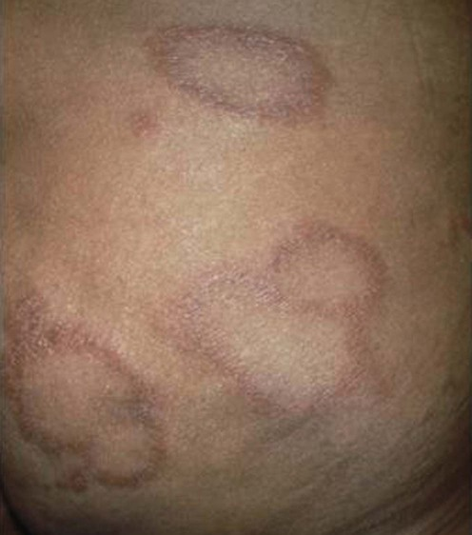
Cardinal signs
Hypopigmented or reddish skin lesions with loss of sensation.
Presence of Acid-Fast Bacilli (AFB) in slit-skin smear.
Thickened peripheral nerves with sensory or motor impairment.
Diagnosis is confirmed if one or more cardinal signs are present.
https://dermnetnz.org/topics/leprosy
Figure 2: Skin lesions

Slide 6
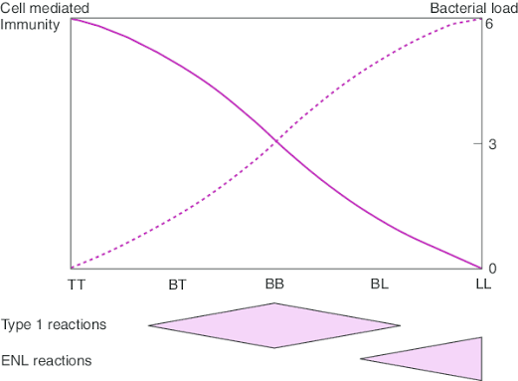
Reaction According to The R-J classification
https://www.researchgate.net/publication/6706057_The_clinical_and_immunological_features_of_leprosy/figures?lo=1&utm_source=google&utm_medium=organic
Fig 5:- The Ridley–Jopling classification and the relationship with host immunity.

Slide 7
Types of reaction
Feature | Type 1 Reaction (Reversal Reaction) | Type 2 Reaction (ENL)
Hypersensitivity Type | Type IV (Delayed hypersensitivity) | Type III (Immune complex hypersensitivity)
Immune Response | Change in cell-mediated immunity | Immune complexes form and deposit in tissues
Occurs In | BT, BB, BL (Borderline leprosy) | Mainly LL, sometimes BL
Other Name | Reversal Reaction | Erythema Nodosum Leprosum (ENL)
Effect on Disease | Disease may improve (upgrading) or worsen (downgrading) | Sudden inflammatory attacks with systemic symptoms
When It Occurs | Usually during the first year of MDT | Before, during, or after MDT; often in the first year
Skin Changes | Existing skin lesions become red, swollen, and painful | New painful red nodules appear
Nerve Involvement | Common and severe; can cause nerve damage | Less common and less severe

Slide 8
Background
As we found Previous studies have demonstrated the persistence of viable M. leprae in some multibacillary patients despite MDT; however, the viability status of bacilli in different clinical conditions remains unclear.
The impact of absence of treatment (new cases), interrupted treatment (defaulters), recurrence after RFT (relapse), and reactional episodes on the viable load whether these differences reflect ongoing bacterial activity..
Molecular viability markers such as 16S rRNA, esxA, and hsp18 can be used to quantify viable bacilli and assess ongoing bacterial activity.

Slide 9
Background
hsp18 (Heat Shock Protein 18)
  Encodes a small heat shock (18-kDa chaperone) protein.
  Protects M. leprae proteins during stress and helps bacterial survival.
  Marker of viable, metabolically active bacilli.
esxA (ESAT-6-like Protein)
  Encodes a secreted virulence-associated protein.
  Involved in host–pathogen interaction and pathogenicity.
  Expression indicates active and viable bacteria.
16S rRNA
  Component of the 30S ribosomal subunit.
  Essential for protein synthesis and ribosome function.
  Sensitive marker for detection and viability of M. leprae.

Slide 10
Rationale of the study
Comparing the viable load of M. leprae among new, relapse, defaulter, Type 1 reaction, and Type 2 reaction patients may help understand bacterial persistence and its association with different clinical presentations of leprosy.

Slide 11
AIM :
To evaluate the molecular viability of Mycobacterium leprae in reactional and non-reactional leprosy patients.
OBJECTIVES :
To check the viable load of M. leprae in reaction & non-reaction leprosy patients Using RT PCR.
To study the comparative analysis of viable load of bacilli in reaction.

Slide 12
Methodology
Study Type : Pilot study
Study Site : TLM Community Hospital, Shahdara, Delhi.
Sample Size : A total of 43 leprosy patients were enrolled.
INCLUSION CRITERIA: Leprosy patients aged 18 to 60 years, including
those with New, Relapse, Defaulters, T1R and T2R cases.
EXCLUSION CRITERIA: Leprosy Patients with any co-morbidities (TB, HIV),
pregnant females, or individuals with any other concurrent diseases were excluded.
Study Population / Sample Size (n=43)
Type 1 Reaction | 10
Type 2 Reaction | 11
Relapse | 3
Defaulter | 4
New | 15

Slide 13
WORK FLOW
Clinically Diagnosed Leprosy Cases (n=43)
Non-Reactional Cases (n=15)
Reactional Cases (n=21)
Defaulter (n=4)
Relapse (n=3)
New (n=15)
T1R (n=10)
T2R (n=11)
Clinical & Demographic Data Collection (SSS)
RNA Isolation (By Rneasy Mini Kit - Cat. no. : 74104) )
RNA Quantification by Invitrogen Thermofisher Scientific kit (Cat. No.: Q32852) using Qubit Fluorometer
cDNA Preparation by Applied Biosystems™ High-Capacity cDNA Reverse Transcription Kit (Cat. No. 4368814)
Molecular Viability Assay (MVA) by targeting 16SrRNA, exsA, hsp18 genes
Descriptive Statistical Analysis (Mean ± SD)

Slide 14
Result
Clinical Group | Non-Reactional Patients | Relapse (n = 03) | Defaulter (n = 04) | Reactional Patients
 | New Patients (n = 15) |  |  | T1R (n = 10) | T2R (n = 11)
16SrRNA (Mean ± SD) | 17882.42 ± 578.12 | 1517.13 ± 582.01 | 1954.25 ± 376.72 | 64698.57 ± 154.31 | 2448.49 ± 180.06
esxA (Mean ± SD) | 87.71 ± 13.89 | 146.58 ± 46.45 | 60.58 ± 38.29 | 104.84 ± 13.43 | 134.14 ± 64.08
hsp18 (Mean ± SD) | 37.57 ± 8.69 | 5.25 ± 1.39 | 2.06 ± 2.30 | 196.69 ± 30.29 | 3.94 ± 1.71
Table no : Mean ± SD expression levels of 16S rRNA, esxA, and hsp18 genes in different clinical groups of patients.

Slide 15
Result
Figure 3: Bar graph representing copy number of genes in logarithmic scale in non-reaction and reactional patients of leprosy

Slide 16
Result
• Expression levels of 16S rRNA, esxA, and hsp18 varied across different clinical categories of leprosy patients.
• T1R patients showed the highest 16S rRNA expression, indicating a substantial viable bacillary load.
• Newly diagnosed cases also exhibited elevated 16S rRNA levels, reflecting active bacillary presence before MDT.
• Relapse patients recorded the highest esxA expression, suggesting persistence of metabolically active bacilli after treatment.
• Increased esxA expression was also observed in T2R patients, indicating ongoing bacterial metabolic activity during reactional episodes.
• T1R patients demonstrated maximum hsp18 expression, reflecting enhanced bacterial stress-response mechanisms.
• Defaulter patients exhibited the lowest esxA and hsp18 expression levels among the study groups.
• The combined assessment of these markers provides insight into bacterial viability, metabolic activity, and stress adaptation in leprosy.

Slide 17
Limitations
Limitations
The study was conducted over a short duration with a limited sample size, which may affect the strength of comparative analysis and generalizability of results.

Slide 18
Conclusion
The molecular viability markers 16S rRNA, esxA, and hsp18 showed distinct expression patterns across different clinical categories of leprosy. 16S rRNA reflected differences in viable bacillary load, esxA was highest in relapse cases, suggesting persistent metabolically active bacilli, and hsp18 was elevated in T1R patients, reflecting a bacterial stress response. Overall, these genes are promising molecular markers for assessing bacterial viability, disease activity, and treatment monitoring in leprosy.

Slide 19
References
World Health Organization. (2024). Global leprosy (Hansen disease) update 2023. https://www.who.int/teams/global-leprosy-programme
Scollard, D. M., Adams, L. B., Gillis, T. P., Krahenbuhl, J. L., Truman, R. W., & Williams, D. L. (2006). The continuing challenges of leprosy. Clinical Microbiology Reviews, 19(2), 338–381. https://doi.org/10.1128/CMR.19.2.338-381.2006
Ridley, D. S., & Jopling, W. H. (1966). Classification of leprosy according to immunity. International Journal of Leprosy, 34(3), 255–273.
Truman, R. W., Andrews, P. K., Robbins, N. Y., Adams, L. B., Krahenbuhl, J. L., & Gillis, T. P. (2008). Enumeration of Mycobacterium leprae using real-time PCR. PLoS Neglected Tropical Diseases, 2(11), e328. https://doi.org/10.1371/journal.pntd.0000328
Martinez, A. N., Ribeiro-Alves, M., Sarno, E. N., & Moraes, M. O. (2011). Evaluation of qPCR-based assays for the detection of Mycobacterium leprae DNA in clinical samples. PLoS Neglected Tropical Diseases, 5(1), e1049. https://doi.org/10.1371/journal.pntd.0001049
Monot, M., Honoré, N., Garnier, T., et al. (2005). On the origin of leprosy. Science, 308(5724), 1040–1042. https://doi.org/10.1126/science.1109759
Cole, S. T., Eiglmeier, K., Parkhill, J., et al. (2001). Massive gene decay in the leprosy bacillus. Nature, 409(6823), 1007–1011. https://doi.org/10.1038/35059006
Turankar, R. P., Pandey, S., Lavania, M., et al. (2012). Differential expression of stress-associated genes (hsp18, esxA) in Mycobacterium leprae and their utility as viability markers. Indian Journal of Medical Research, 136, 483–489.
Britton, W. J., & Lockwood, D. N. J. (2004). Leprosy. The Lancet, 363(9416), 1209–1219. https://doi.org/10.1016/S0140-6736(04)15952-7
National Leprosy Eradication Programme (NLEP). (2023). Operational Guidelines for Leprosy Control in India. Ministry of Health & Family Welfare, Government of India. https://nlep.nic.in/

Slide 20
Thank You

